Slide 1
ADO.NET

Slide 2
ADO.NET Overview
ADO .NET is a collection of classes, interfaces, structures, and enumerated types that manage data access from relational data stores within the .NET Framework
These collections are organized into namespaces:
System.Data, System.Data.OleDb, System.Data.SqlClient, etc.
ADO .NET is an evolution from ADO.
Does not share the same object model, but shares many of the same paradigms and functionality!

Slide 3
ADO.NET – Managed Providers
Your Application
Each provider contains a set of classes that implement common interfaces
ADO.NET Managed Provider
SQL Managed Provider
ADO Managed Provider
OLE DB Provider
SQL Server Database
Database

Slide 4
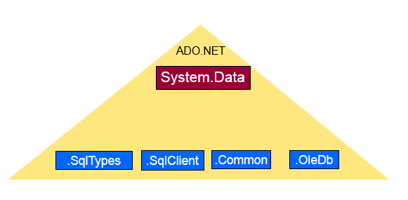
Architecture
The ADO.NET Object Model
Objects of System.Data
.NET data providers
ADO.NET namespace hierarchy
Organizes the object model
Includes:
System.Data
System.Data.OleDb
System.Data.Common
System.Data.SqlClient
System.Data.SqlTypes

Slide 5
Components
two main components of ADO.NET 3.0 for accessing and manipulating data are:
the .NET Framework Data Providers and
the DataSet.

Slide 6
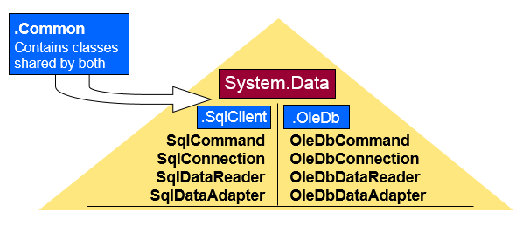
Introducing the Objects
System.Data
Contains the “main” classes of ADO.NET
In-memory cache of data
In-memory cache of a database table
Used to manipulate a row in a DataTable
Used to define the columns in a DataTable
Used to relate 2 DataTables to each other
Used to create views on DataSets
DataSet
.NET Data Providers Hierarchy
DataTable
DataRow
DataColumn
DataRelation
DataViewManager
System.Data Namespace Contains the basis and bulk of ADO.NET

Slide 7
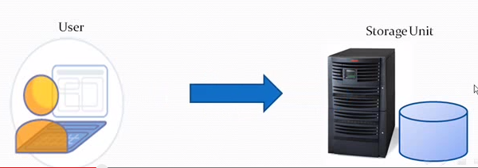
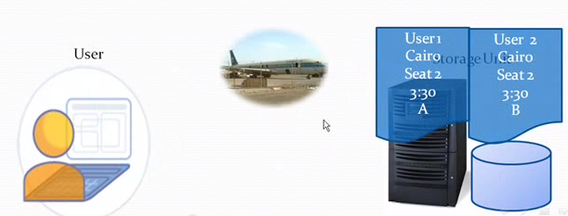
Connection ADO.NET
The .NET Framework Data Providers

Slide 8
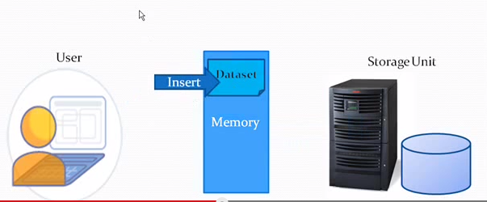
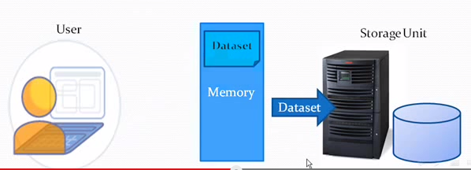
Connection-Less ADO.NET (DataSet)
The ADO.NET DataSet is explicitly designed for data access independent of any data source
it can be used with multiple and differing data sources
used with XML data, or used to manage data local to the application
Dataset in Memory
When done persist data from dataset to database
The DataSet contains a collection of one or more DataTable objects consisting of rows and columns of data, and also primary key, foreign key, constraint, and relation information about the data in the DataTable objects

Slide 9
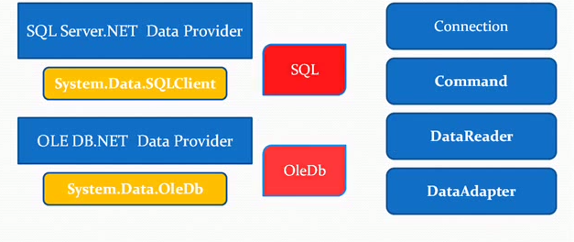

The .NET Framework Data Providers
Allows us to connect, retrieve and work with databases
Namespace:
System.Data.?
A .NET Framework data provider is used for connecting to a database, executing commands, and retrieving results.
Those results are either processed directly, placed in a DataSet in order to be exposed to the user as needed, combined with data from multiple sources, or remoted between tiers.
Data Provider Extension Classes

Slide 10
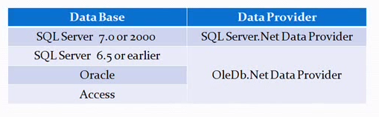
Which Data Provider to use?
The following table lists the data providers that are included in the .NET Framework.
.NET Framework data provider | Description
.NET Framework Data Provider for SQL Server | Provides data access for Microsoft SQL Server. Uses the System.Data.SqlClient namespace.
.NET Framework Data Provider for OLE DB | For data sources exposed by using OLE DB. Uses the System.Data.OleDb namespace.
.NET Framework Data Provider for ODBC | For data sources exposed by using ODBC. Uses the System.Data.Odbc namespace.
.NET Framework Data Provider for Oracle | For Oracle data sources. The .NET Framework Data Provider for Oracle supports Oracle client software version 8.1.7 and later, and uses the System.Data.OracleClient namespace.
EntityClient Provider | Provides data access for Entity Data Model (EDM) applications. Uses the System.Data.EntityClient namespace.
.NET Framework Data Provider for SQL Server Compact 4.0. | Provides data access for Microsoft SQL Server Compact 4.0. Uses the System.Data.SqlServerCe namespace.

Slide 11
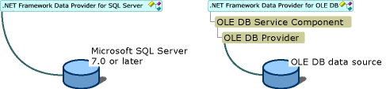
.NET Framework Data Provider for SQL Server (SqlClient)
SqlClient uses its own protocol to communicate with SQL Server
Namespace:
C#
using System.Data.SqlClient;
VB
Imports System.Data.SqlClient

Slide 12
The .NET Framework Data Provider for OLE DB (OleDb)
OlesDb uses native OLE DB
Namespace:
C#
using System.Data.OleDb;
VB
Imports System.Data.OleDb
The following table shows the providers that have been tested with ADO.NET.
Driver | Provider
SQLOLEDB | Microsoft OLE DB provider for SQL Server
MSDAORA | Microsoft OLE DB provider for Oracle
Microsoft.Jet.OLEDB.4.0 | OLE DB provider for Microsoft Jet

Slide 13
The .NET Framework Data Provider for ODBC
OlesDb uses native ODBC driver manger
Namespace:
C#
using System.Data.Odbc;
VB
Imports System.Data.ODbc
The following table shows the ODBC drivers tested with ADO.NET..
Driver
SQL Server
Microsoft ODBC for Oracle
Microsoft Access Driver (*.mdb)

Slide 14
The .NET Framework Data Provider for Oracle (OracleClient)
OracleClient enables data access to Oracle data sources through Oracle client connectivity software
Namespace:
C#
using System.Data; using
System.Data.OracleClient;
VB
Imports System.Data
Imports System.Data.OracleClient

Slide 15
.NET Objects
The Connection object provides connectivity to a data source.
The Command object enables access to database commands to return data, modify data, run stored procedures, and send or retrieve parameter information.
The DataReader provides a high-performance stream of data from the data source.
The DataAdapter provides the bridge between the DataSet object and the data source
DataSets. For storing, remoting and programming against flat data, XML data and relational data.
In-memory

Slide 16
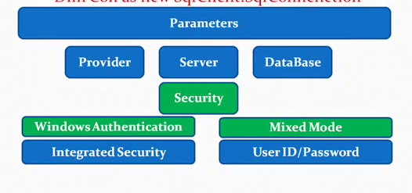
Connection String
In ADO.NET you use a Connection object to connect to a specific data source by supplying necessary authentication information in a connection string.
The Connection object you use depends on the type of data source.
Dim Con as new SqlClient.SqlConnection (Parameters)
Parameters:
Provider (SqlClient)
Server
Database
Authentication
Mixed Mode
User ID and Password
Window Authentication
Integrated Security
Timeout
Pooling

Slide 17
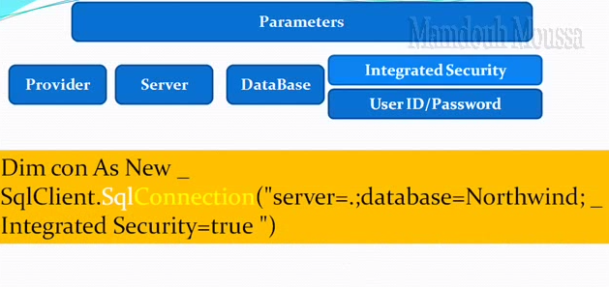
Connection String
Provider
SqlClient
Or for OleDb
Provider=“Microsoft.jet.oledb.4.0”
Server
Server=.; or localhost
Database
Database=Northwind;
Integrated Security or
User Id=sa;
Password=“blaBla”

Slide 18
Connection String
SqlClient
OleDb
C#
using (SqlConnection connection = new SqlConnection(connectionString))
{
connection.Open();
// Do work here.
}
String conStr = "Provider=Microsoft.Jet.OLEDB.4.0;" + Data Source = NWIND_RW.MDB";
using (OleDbConnection connection =
new OleDbConnection(conStr))
{
connection.Open();
// Do work here.
}

Slide 19
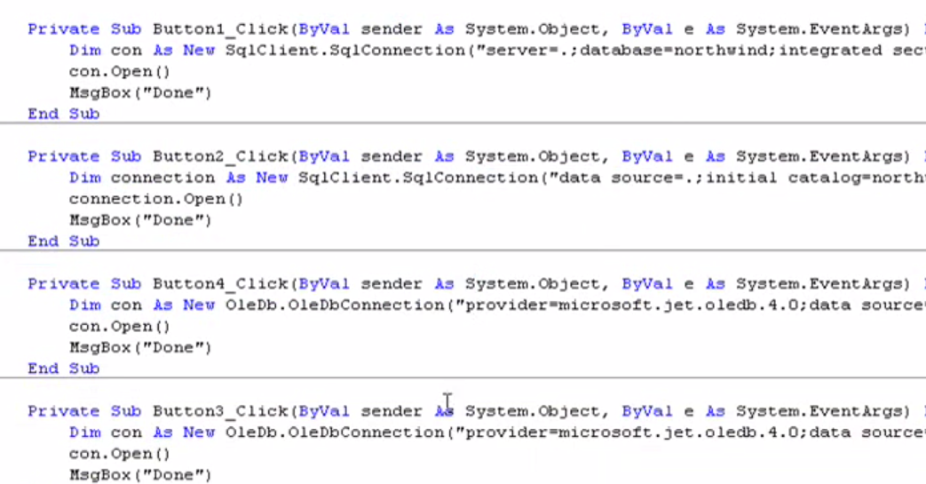
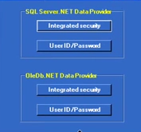
Sample Connections

Slide 20
Data Connection Properties
SQL Server Name
Default name of the MSDE version of SQL Server is MachineName\NetSDK
MachineName is the name of your local computer
Also referred to as (local)\NetSDK or localhost
Not required in the Connection String – assumed to be SQL Server if it uses the SQLClient class

Slide 21
SQL Server Connection Pooling (ADO.NET)
Connecting to a database server typically consists of several time-consuming steps:
A physical channel such as a socket or a named pipe must be established,
the initial handshake with the server must occur,
the connection string information must be parsed,
the connection must be authenticated by the server,
checks must be run for enlisting in the current transaction,
and so on.

Slide 22
SQL Server Connection Pooling (ADO.NET)
In practice, most applications use only one or a few different configurations for connections.
This means that during application execution, many identical connections will be repeatedly opened and closed.
To minimize the cost of opening connections, ADO.NET uses an optimization technique called connection pooling.

Slide 23
SQL Server Connection Pooling (ADO.NET)
Connection pooling reduces the number of times that new connections must be opened.
The pooler maintains ownership of the physical connection.
It manages connections by keeping alive a set of active connections for each given connection configuration.
Whenever a user calls Open on a connection, the pooler looks for an available connection in the pool.
If a pooled connection is available, it returns it to the caller instead of opening a new connection.
When the application calls Close on the connection, the pooler returns it to the pooled set of active connections instead of closing it.
Once the connection is returned to the pool, it is ready to be reused on the next Open call.

Slide 24
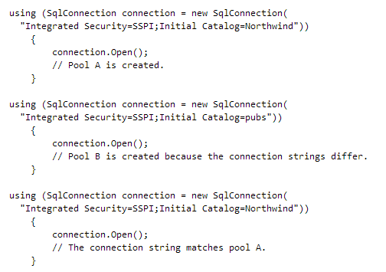
SQL Server Connection Pooling (ADO.NET)
I

Slide 25
.NET Object – Next Time
The Connection object provides connectivity to a data source.
The Command object enables access to database commands to return data, modify data, run stored procedures, and send or retrieve parameter information.
The DataReader provides a high-performance stream of data from the data source.
The DataAdapter provides the bridge between the DataSet object and the data source

